Slide 1
ITS ABOUT TO BEGIN

Slide 2
WELCOME
TO

Slide 3
Homechoice

Slide 4
COMMS
SESSION

Slide 5
JULY 2020

Slide 6
ICT COMMS JULY 2020

Slide 7






AGENDA
NEWBIES

Slide 8
AGENDA
BIRTHDAYS

Slide 9
AGENDA
IRL NEWS

Slide 10
AGENDA
PROJECT UPDATES

Slide 11
AGENDA
TECH NEWS

Slide 12

AGENDA
MANAGER UPDATE

Slide 13
NEWBIES
I’m XX XXX
Let me tell you the story of ME

Slide 14
BIRTHDAYS
JULY
AUGUST
XXXX
XXX

Slide 15
.
WHATS HAPPENING IN REAL LIFE?

Slide 16
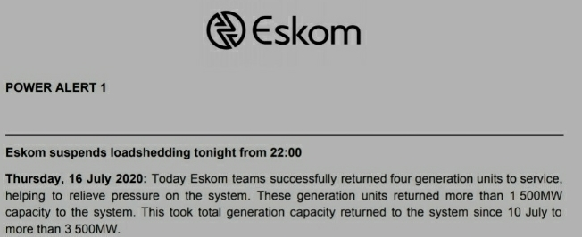
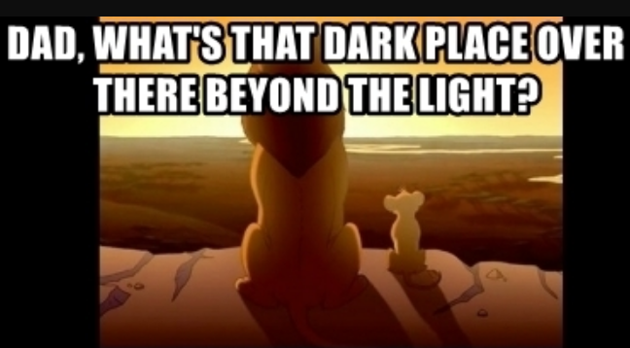
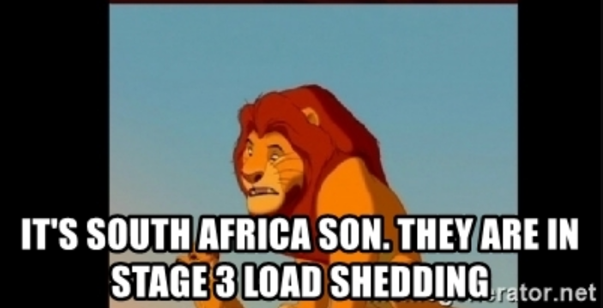
LOAD SHEDDING IS OVER!!!!
Eskom suspends
load-shedding as of 16th July

Slide 17
WHATS ACTUALLY HAPPENING

Slide 18
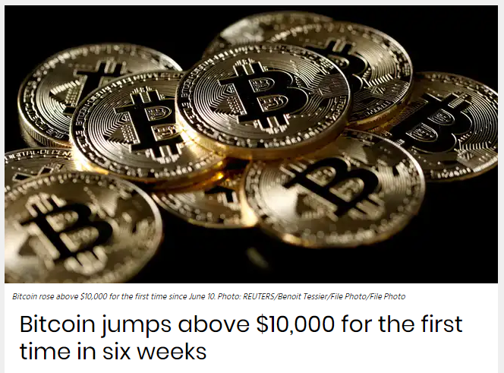
Notes:
So BITCOIN has made a strong recovery in recent history, despite the corona virus… but I do wonder if it has anything to do with…. Our next story.

Slide 19
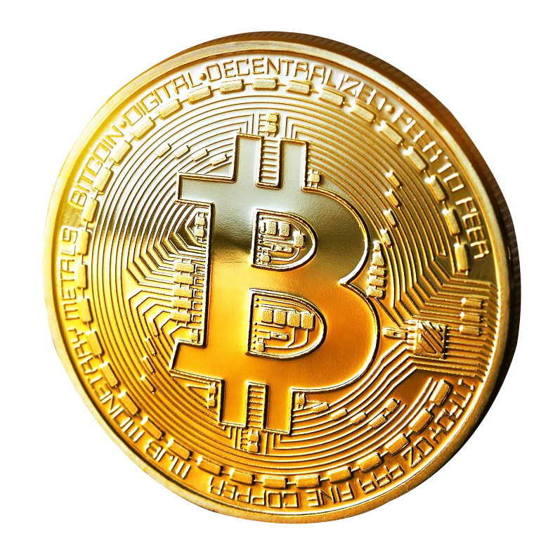

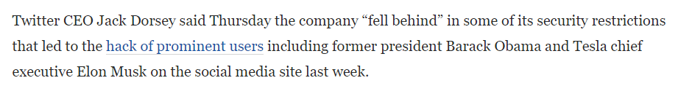
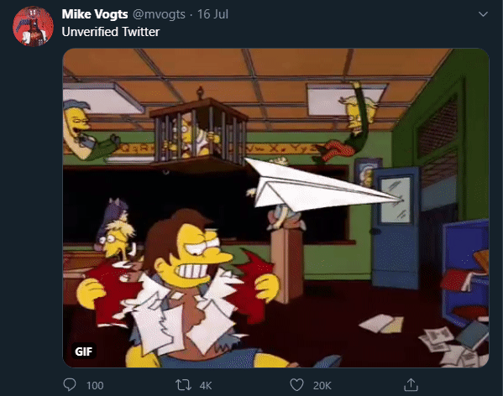
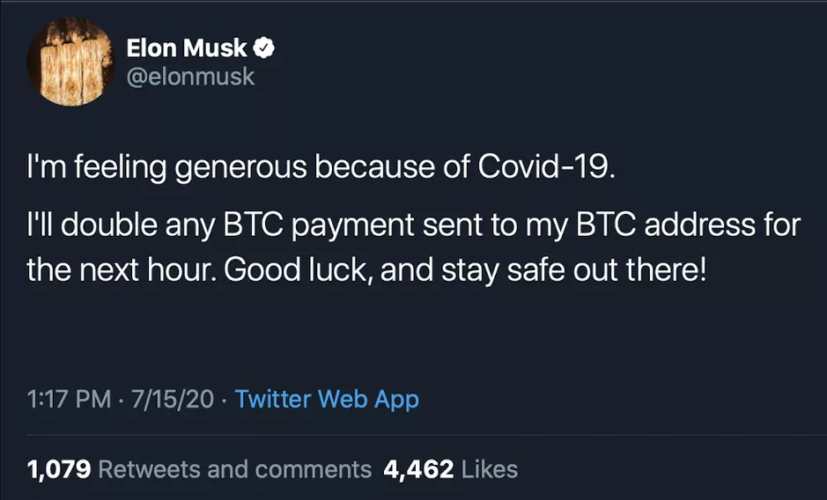
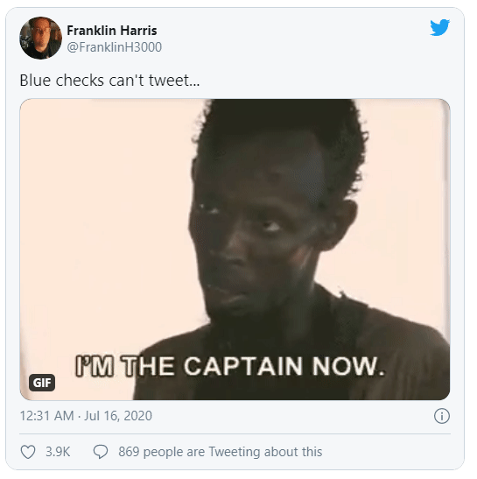
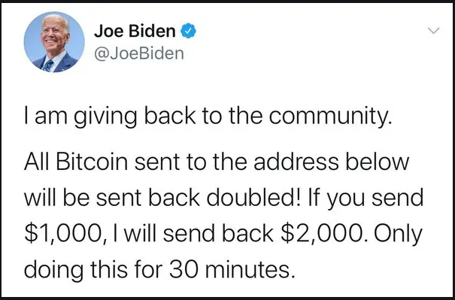
MASS-SCALE TWITTER HACK
Notes:
- It was a bad day even by Twitter standards. In what is being dubbed as one of the “most brazen online attacks in memory”, the most powerful Twitter accounts in the US were all tweeting about Bitcoins.
In a couple of hours, it had taken over the handles of Barack Obama, Biden, Bill Gate, Elon Musk, Apple’s official account, Uber, and eve Amazon founder Jeff Bezos.
Eventually Twitter had locked most large verified accounts across the US and rest of the world.
So basically, all the “official” blue-check mark accounts and all that was left was crazy anarchy as 1000s of people didn’t know what to do with themselves.
In the four hours that those tweets were live, the Bitcoin wallet promoted in the tweets received over $100,000 via at least 300 transactions.
So, not really that much damage if you think about it..
After investigating, Twitter Support said the hack was “coordinated social engineering attack” executed by people who “successfully targeted some of our employees with access to internal systems and tools”.
LAZ, you need to stop using that BRIAN Password RIGHT NOW!!!!
So, a lesson learnt by one of the biggest companies in the world: SECURITY – Top to bottom…

Slide 20
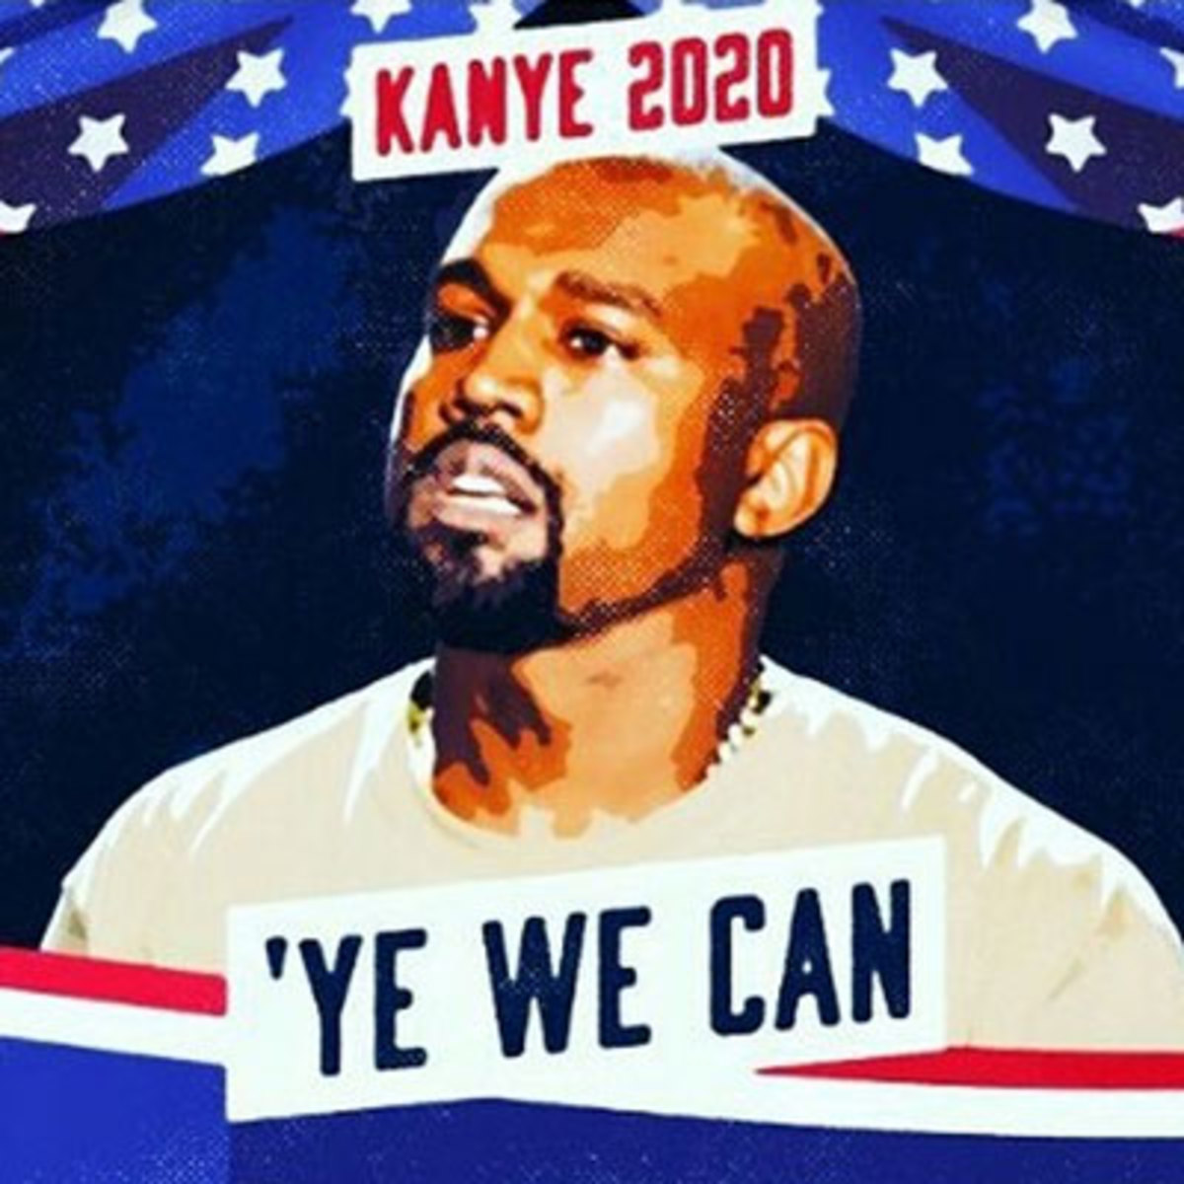

Well, I know who I’m voting for
Notes:
Kanye West announced his 2020 United States presidential election campaign through Twitter on July 4, 2020, Independence Day.
In case you think this was just a stunt for his new album.. NOPE….
On July 16, 2020, the campaign filed a Statement of Candidacy with the Federal Election Commission.
MXM … I wish I could vote in AMERICA!!.. PRESSIDENT .. YEEEEEAH.
And now… On to some ACTUALLY BAAAD NEWS….

Slide 21
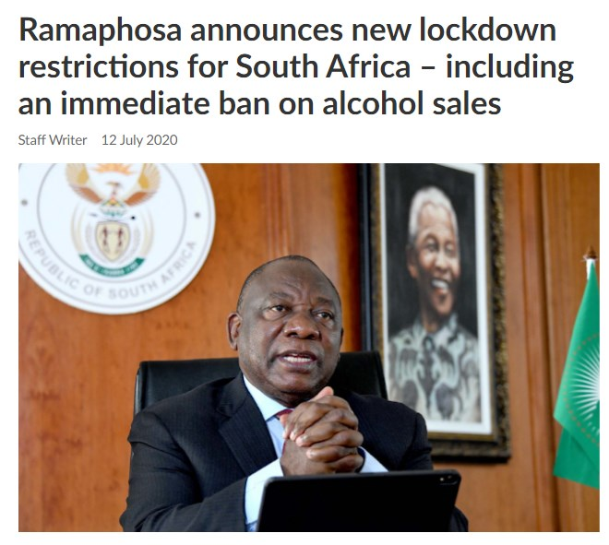
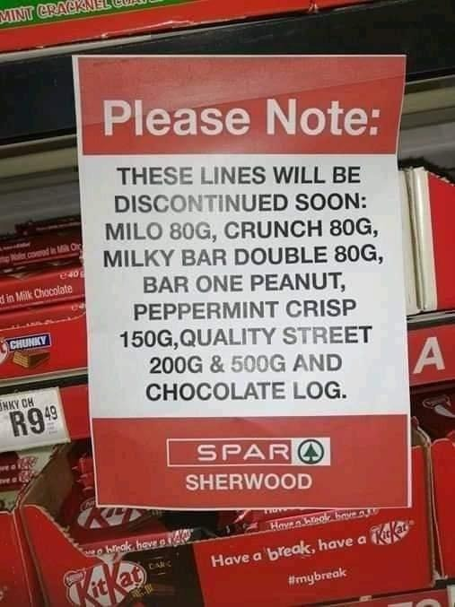

BAD NEWS
Notes:
ALCOHOL banned again in South Africa..
What excuse am I supposed to use now when I’m driving fast on the Highway???
The other bad news, for some reason, SPAR is running out of Chocolate..
I wonder if the same people who bought all the toilet paper are now buying all the Chocolate because they don’t have booze anymore..
At least though, without booze, People who are stuck in lockdown are starting to become more innovative.
They’re inventing new things.. New words for the URBAN Dictionary
And they’re changing what we currently understand..

Slide 22
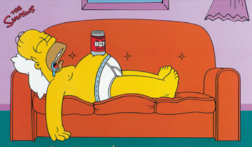

Corona on OUR TERMS
Quarantinis
2019: LAZY LOUT
Coughin’ dodger
Fattening the curve
2020: RESPONSIBLE ADULT
Notes:
Quarantinis
Experimental cocktails mixed from whatever random ingredients you have left in the house.
Typically non-alchoholic. LOTS OF SUGAR!!!! ☺
Coughin’ dodger
NO.. Not old People.. Not those guys dancing with the coffin above their heads… Instead..
A coughin dodger refers to someone so scared by a throat-clear or a tiny cough, that they back away in terror and call the police lock the 'infected one' up... Clear my throat. That was a coincidence.. I swear…
And Finally,
Fattening the curve
It doesn't matter how many workouts you do, it won't cancel out all the banana bread, Quarantinis and general comfort eating and drinking... but who cares, normal rules don't apply during lockdown!

Slide 23

PROJECT UPDATES
Notes:
First-up… Our Good Friends From FINCHOICE..

Slide 24
FINCHOICE
EXCITING NEWS FROM THE WORLD OF FINANCE !!!
UPDATE
UPDATE
UPDATE
Notes:
So, very unfortunately, Finchoice (JP & Danie) weren’t able to make it for this comms session, but they did send me an update – which I can apparently access on their website by clicking on the “Update” button..

Slide 25


Slide 26
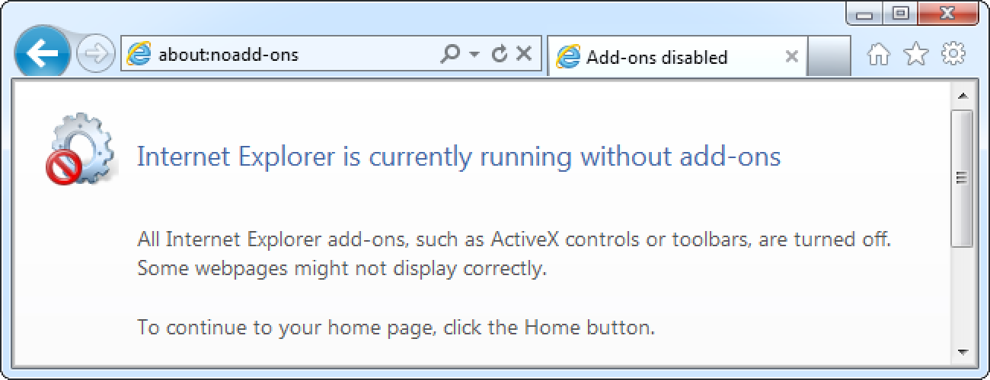





https://www.finchoice.co.za/Updates
Cannot reach page
I FIND YOUR LACK OF UPDATES DISTURBING

Slide 27
HC PROJECT UPDATES

Slide 28

xxx Teams
COMING SOON
DEPLOYMENTS
XXX
XXX
XXX
XXX
XXX
XXX
28
Notes:
ALBERT to talk to this one..

Slide 29



XXX
COMING SOON
DEPLOYMENTS
XXXXXX
XXX
XXX
XX
XXX
XXX
XXX
XXX
X
29

Slide 30
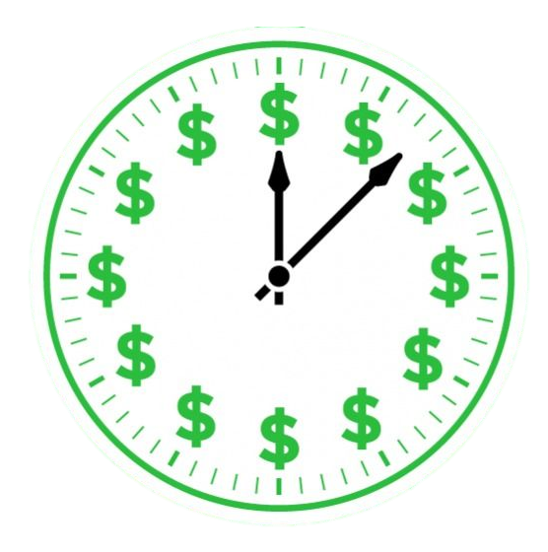



CCCC
COMING SOON
xxxx
Price List
30

Slide 31



XXX
COMING SOON
DEPLOYMENTS
xxx
xxx
xxx
xx
xxx
XXX
‘xxx has had a 3rd op for the year I think. Bionic arms’ - T
XXX
xxx
31

Slide 32



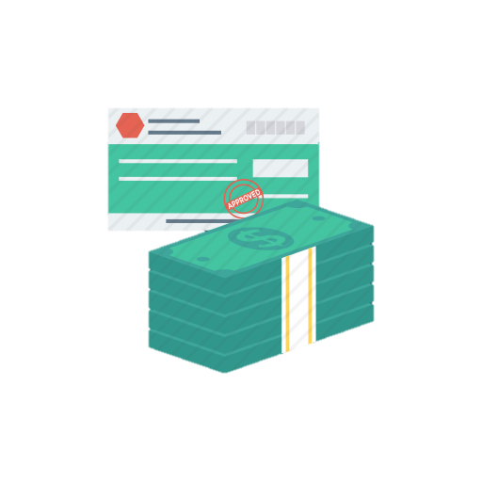
XXX
COMING SOON
XXX
XXX
XXX
XXX
TAZ KNOWS
‘xxxx’ - G
32

Slide 33

XXX
DEPLOYMENTS
XXXX
XXX
XXX
xxxx
xxx
xxxx

Slide 34
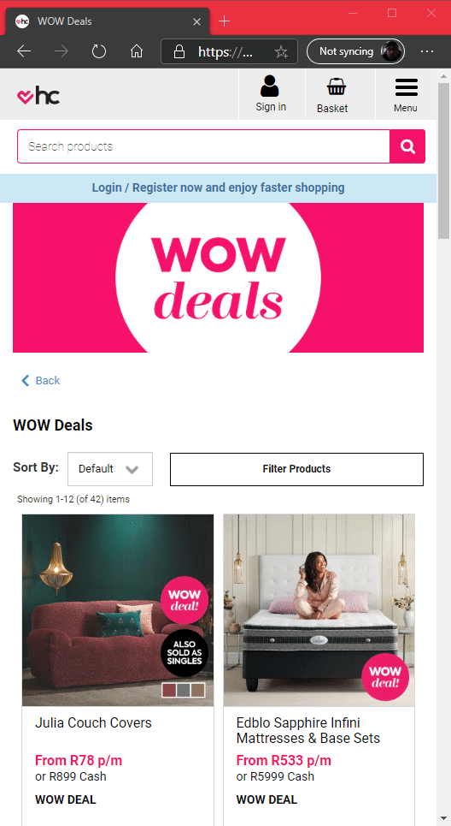
xxx
COMING SOON
XXX
XXX
XXX
XXX
XXXX
XXX
XXXXX
XXX

Slide 35

TECH NEWS

Slide 36

R890,526,124
185,244 users
100%
MANAGERS
UPDATES
That’s a lot of money
And a lot of users
GREAT SUCCESS!!!

Slide 37


